Slide 1
Natural User Interfaces

Slide 2
NUI Natural User Interfaces
“Until now, we have always had to adapt to the limits of technology and conform the way we work with computers to a set of arbitrary conventions and procedures. With NUI, computing devices will adapt to our needs and preferences for the first time and humans will begin to use technology in whatever way is most comfortable and natural for us.”
—Bill Gates, co-founder of the multinational technology company Microsoft

Slide 3
Defining NUIs is difficult, but often when we think about user interfaces that are natural and easy to use, we think of user interfaces where the interaction is direct and consistent with our ‘natural’ behaviour.
source: https://www.interaction-design.org/literature/article/natural-user-interfaces-what-are-they-and-how-do-you-design-user-interfaces-that-feel-natural

Slide 4
Natural User Interfaces
A natural user interface, or NUI, is a user interface that is effectively invisible, and remains invisible as the user continuously learns increasingly complex interactions.
The word natural is used because most computer interfaces use artificial control devices whose operation has to be learned. An NUI relies on a user being able to quickly transition from novice to expert.
While the interface requires learning, that learning is eased through design which gives the user the feeling that they are instantly and continuously successful.
Thus, "natural" refers to a goal in the user experience – that the interaction comes naturally, while interacting with the technology, rather than that the interface itself is natural.

Slide 5
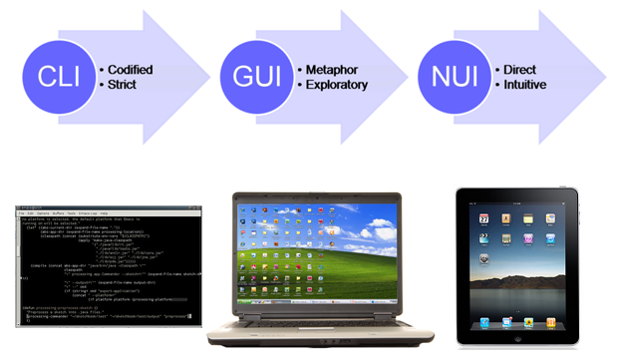

Slide 6
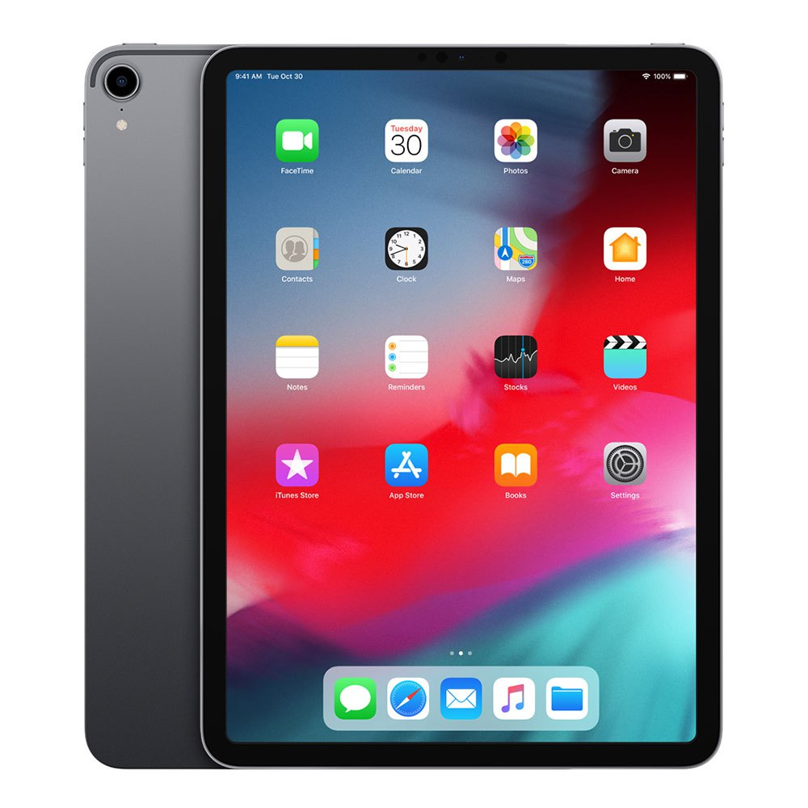
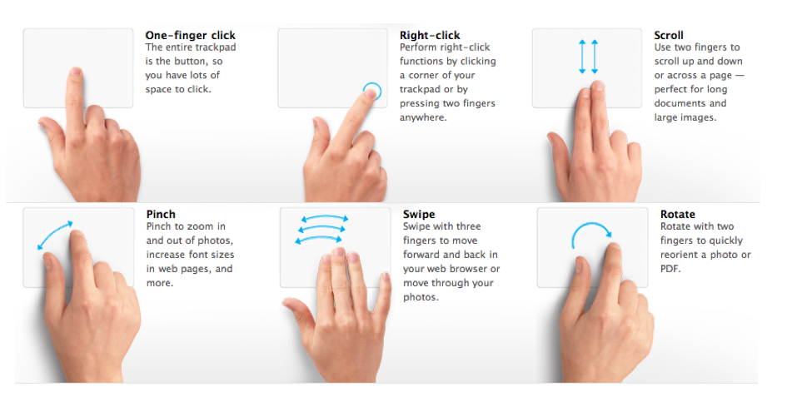
Natural User Interfaces
NUI contrasted with the idea of an intuitive interface, referring to one that can be used without previous learning. Several design strategies have been proposed which have met this goal to varying degrees of success.

Slide 7
Natural User Interfaces
Some iPad gestures come naturally and intuitively—e.g., swiping with one finger to the left or right—which is all part of the ‘magic’ that took the iPad to such prominence.
When you swipe with one finger, you scroll through pages or you move content from one side of the screen to the other. The gesture itself corresponds to the action you are performing.
it shows the power of the principle here—things in the ‘digital world’ behave as they do in the ‘analogue world’.
Some gestures, though, require more learning—e.g., a four-finger swipe to the left or right. The four-finger swipe is not intuitive—it doesn’t come naturally to us. Swiping with four fingers requires you as a user to learn it as a dedicated movement, because you need an understanding of the underlying system

Slide 8
Natural User Interfaces
“Voice, gesture, touch does not necessarily Natural User Interface make.”
—Bill Buxton, Principal Researcher at Microsoft
Microsoft has done a lot of research into NUIs.
NUIs exploit skills that we have acquired through a lifetime of living in the world, which minimizes the cognitive load and therefore minimizes the distraction.
NUIs should always be designed with the use context in mind. No user interface can be natural in all use contexts and to all users.
While gestures, voice and touch are important components of many NUIs, they will only feel natural to a user if they match her skill level and her use context.

Slide 9
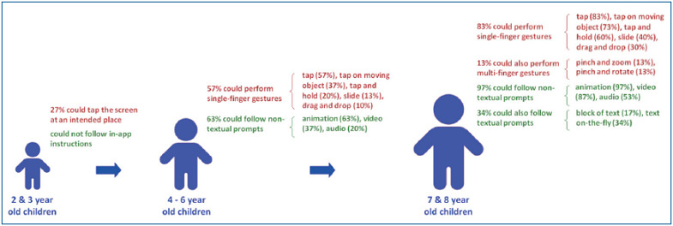
Natural means no learning
Two- and 3-year-old children could not follow any prompting technique and only a minority (27%) could tap the touchscreen at an intended place. Four- to 6-year-old children could perform simple gestures like a tap and slide (57%) and follow instructions provided through animation (63%). Seven- and 8-year-old children could perform more sophisticated gestures like dragging and dropping (30%) and follow instructions provided in audio and video formats (34%). source here

Slide 10
Joshua Blake lists four guidelines for designing NUIs
Instant expertise
Progressive learning
Direct interaction
Low cognitive load (primarily use innate abilities and simple skills)
more info here https://www.interaction-design.org/literature/article/natural-user-interfaces-what-are-they-and-how-do-you-design-user-interfaces-that-feel-natural

Slide 11
NUI in a nutshell
An NUI is a user interface that feels natural to use because it fits the skills and context of the user.
An NUI should take advantage of the users’ existing skills and knowledge.
An NUI should have a clear learning path and allow both novice and expert users to interact in a natural way.
Interaction with an NUI should be direct and fit the user’s context.
Whenever possible, you should prioritize taking advantage of the user’s basic skills.
great design is about satisfying needs, not outsmarting users.

Slide 12
Reality Based Interfaces
One strategy for the design of NUI is the use of a "reality user interface" ("RUI"), also known as "reality-based interfaces" (RBI) methods.
One example of an RUI strategy is to use a wearable device to render real-world objects "clickable", i.e. so that the wearer can click on any everyday object so as to make it function as a hyperlink, thus merging cyberspace and the real world.
Because the term "natural" is evocative of the "natural world", RBI are often confused for NUI, when in fact they are merely one means of achieving it.

Slide 13
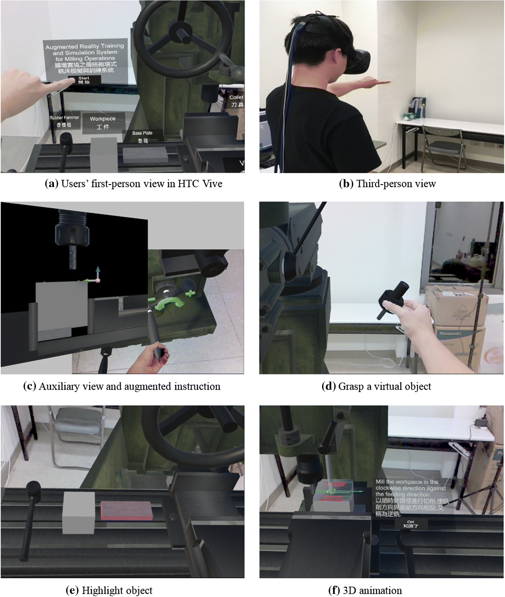
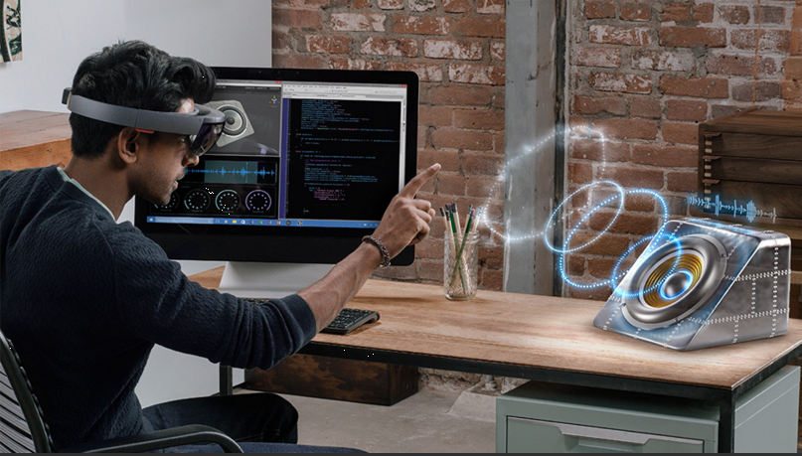
https://www.youtube.com/watch?v=LZWnGo_IsDw&ab_channel=RUISVR

Slide 14
Natural User Interfaces without RBI
One example of a strategy for designing a NUI not based in RBI is the strict limiting of functionality and customization, so that users have very little to learn in the operation of a device.
Provided that the default capabilities match the user's goals, the interface is effortless to use.
This is an overarching design strategy in Apple's iOS. https://www.youtube.com/watch?v=qhEt1Pd-twM&ab_channel=phototristan
Because this design is coincident with a direct-touch display, non-designers commonly misattribute the effortlessness of interacting with the device to that multi-touch display, and not to the design of the software where it actually resides.

Slide 15
CEEDs project
https://www.youtube.com/user/ceedsproject

